Slide 1
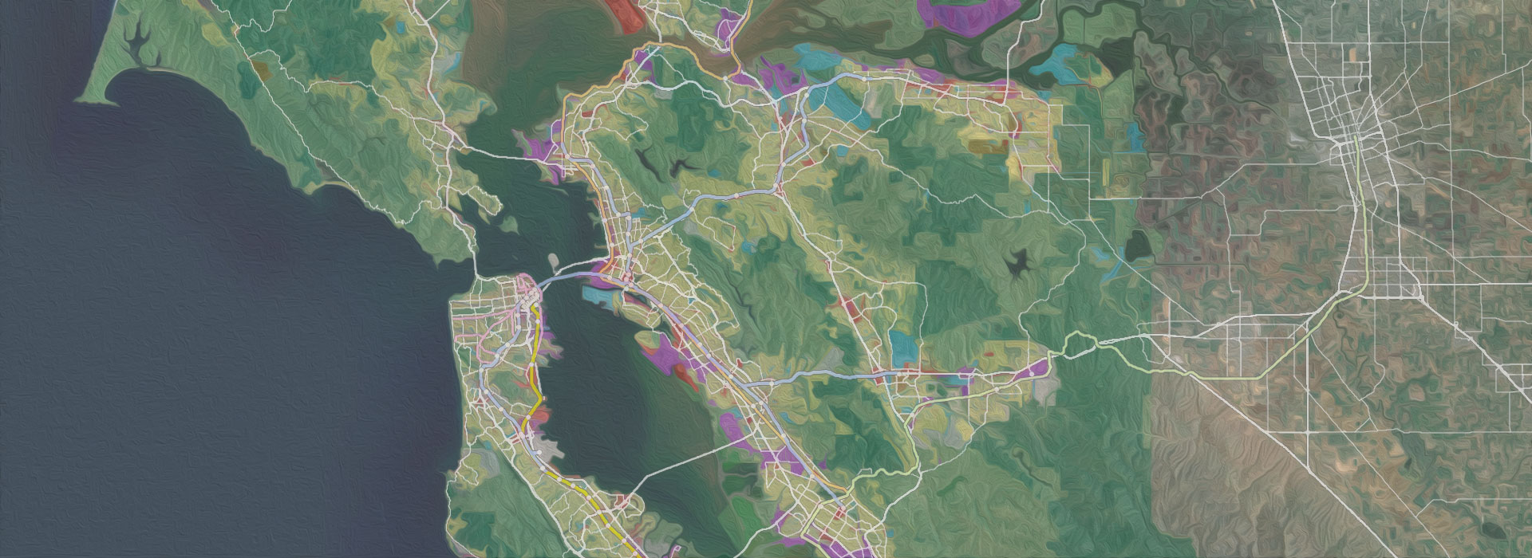
Analytical Services Internship
Complex Universe of Data

Slide 2
Introduction
“Garbage In, Garbage Out” phrase by Neil Hoke, Administrative Assistant to John E. Steward/First Director of the IRS National Computer Center, cited in many newspapers across the country on April 1st 1963 (IRS History)
“Garbage In, Garbage Out” came to its abbreviation, similar to those in accounting terms FIFO and LIFO, “GIGO” in 1964.

Slide 3
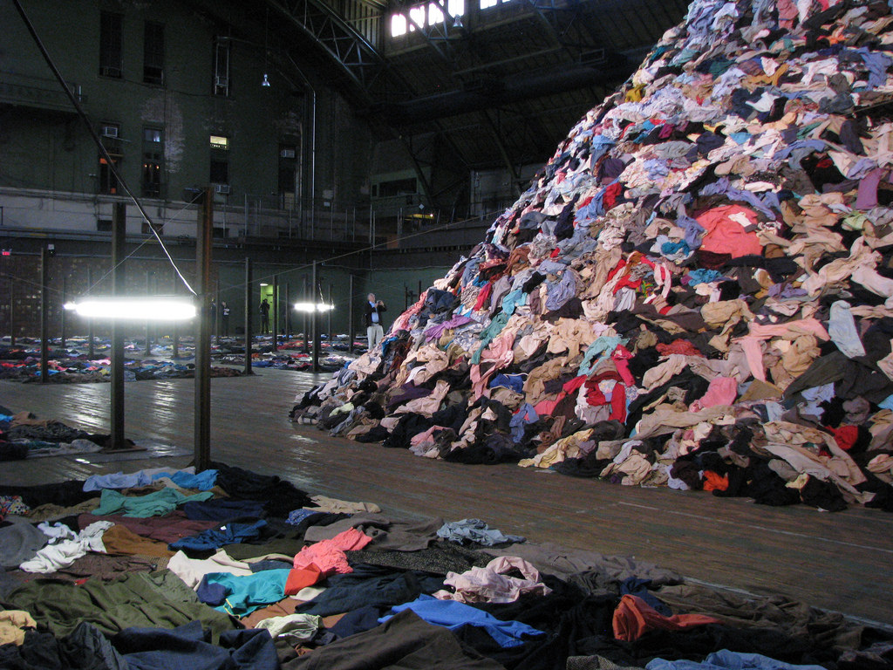

Closet full of “laundry”
Process

Slide 4
Why?
“IDC “[International Data Corporation]” surveys find that the time spent searching for information averages 8.8 hours per week.”
This internship was not an exclusion from the above, since many of you have not responded to the Initial Data Survey due to the amount of time it will take to provide the information.
“By 2020 IDC predicts the amount of digital information will grow by a factor of 30, the number of files, by a factor of 60”.

Slide 5
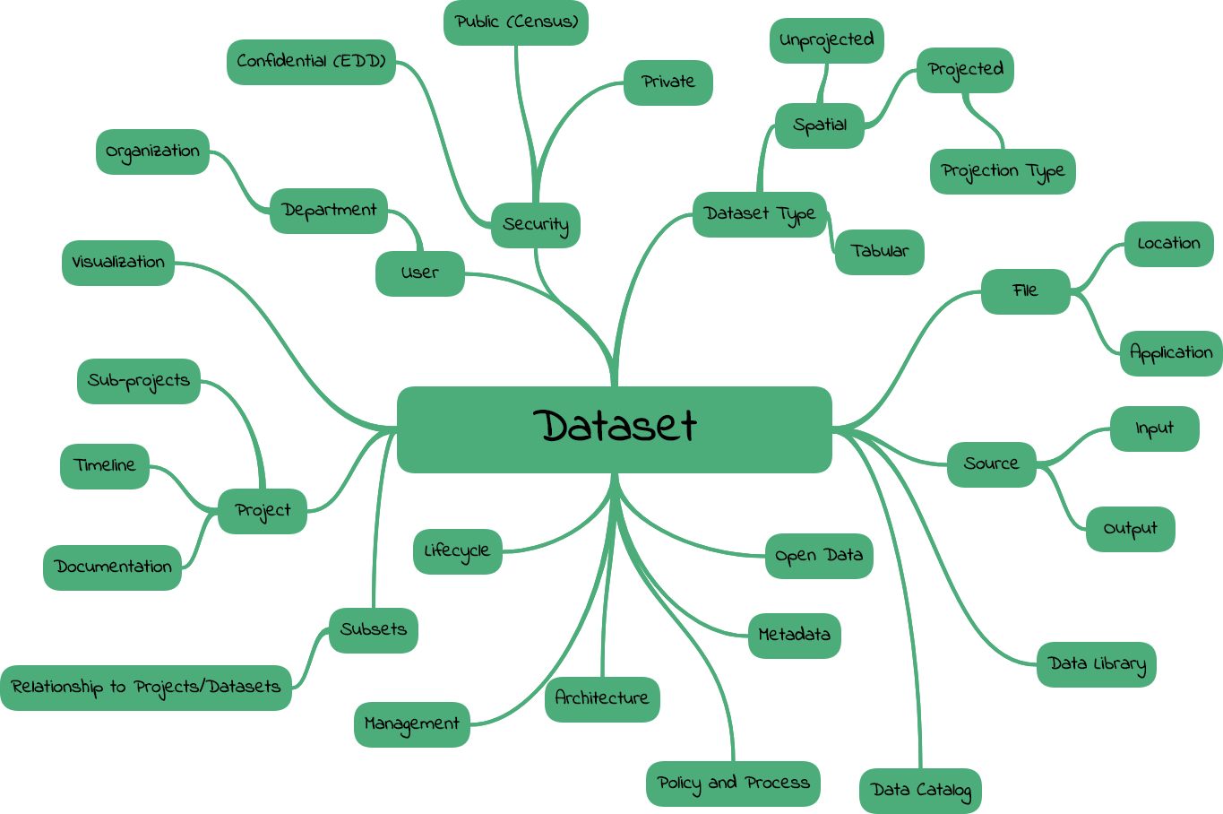
Complexity of MTC Data

Slide 6
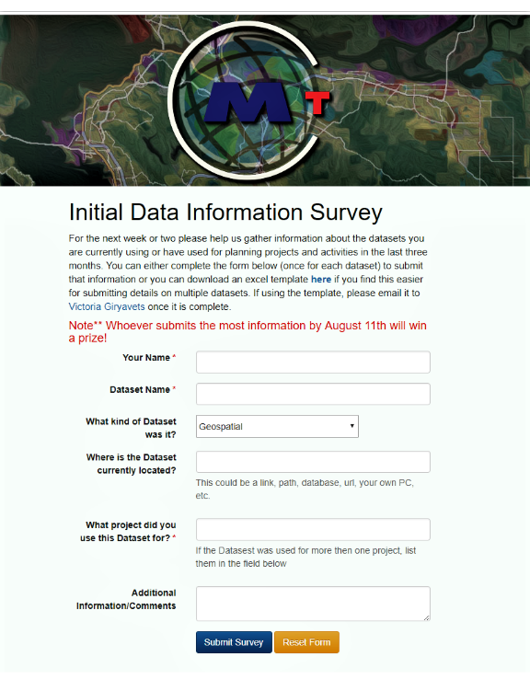
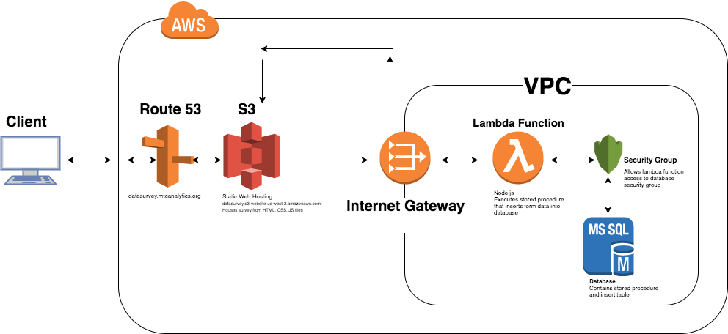
Initial Data Survey

Slide 7
Survey Results
“Survey” was not completed by more then 50 % of recipients due to several reasons: low priority, skepticism, volume of data, organization and existing tasks.
Reality is that only less then 30% need to be checked for the inventory and even lesser amount of data needs to be discoverable

Slide 8
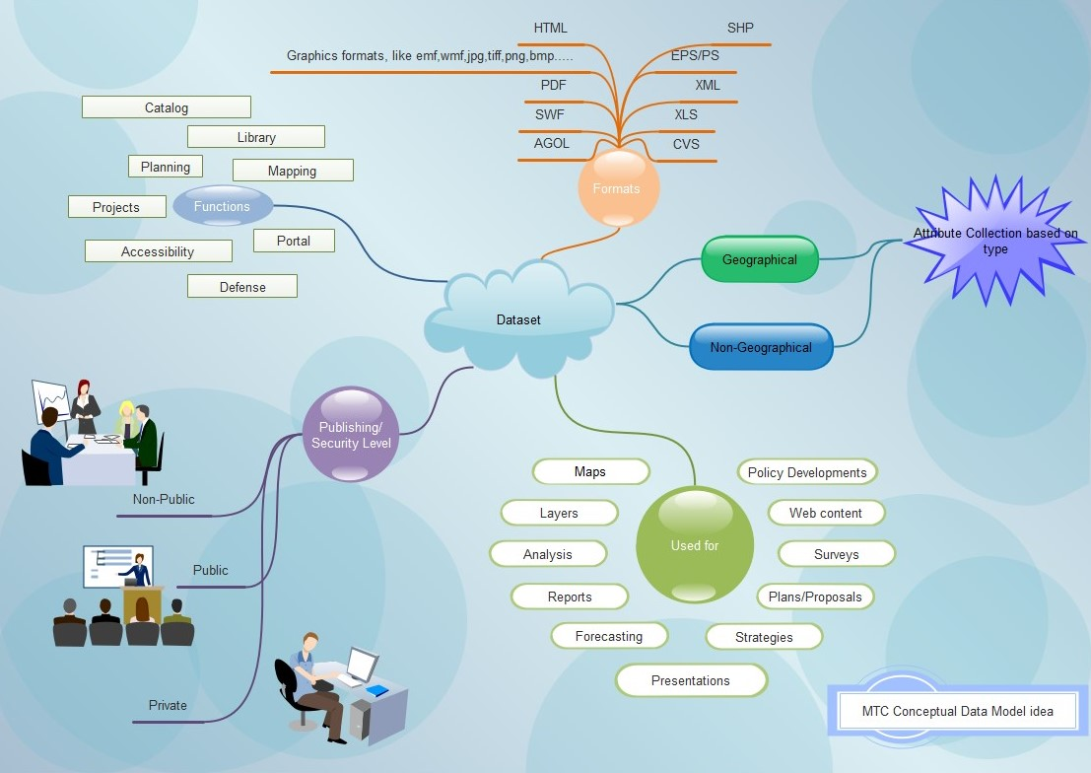
Visualizing Information

Slide 9
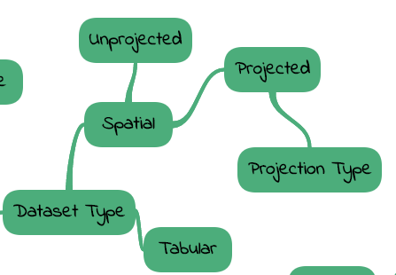
Internship Concentration
With the time, availability and complexity constrains – concentrate on high level conceptual design for the data model

Slide 10
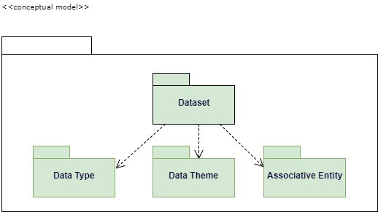
MTC Conceptual Data Model Strategy Planning

Slide 11
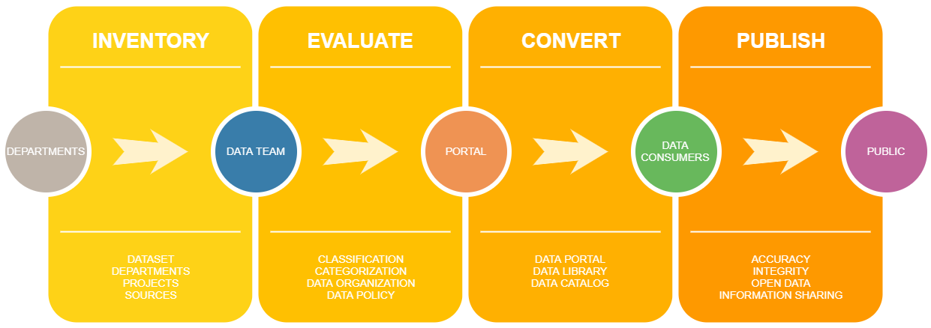
Conclusion
Define User Requirements
Develop Conceptual Data Model
Develop a logical data model
Develop physical data model
Test Data model
Dataset Inventory Submission Form
MTC Conceptual Data Model Strategy Planning

Slide 12
Further Development
Comprehensive Data Audit
Smart Data: Tracking and Submission Forms
Open Data Catalog, Library and Portal

